Slide 1

INTRODUCTION
Bluwage

Slide 2
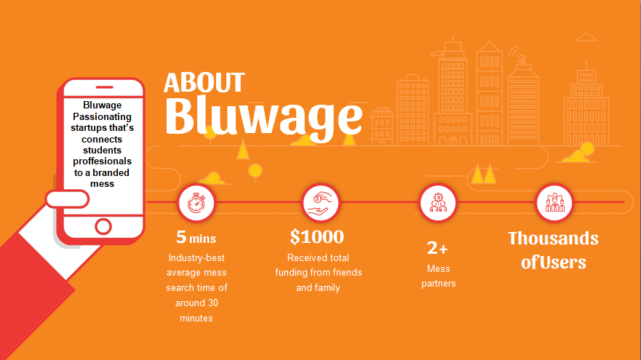
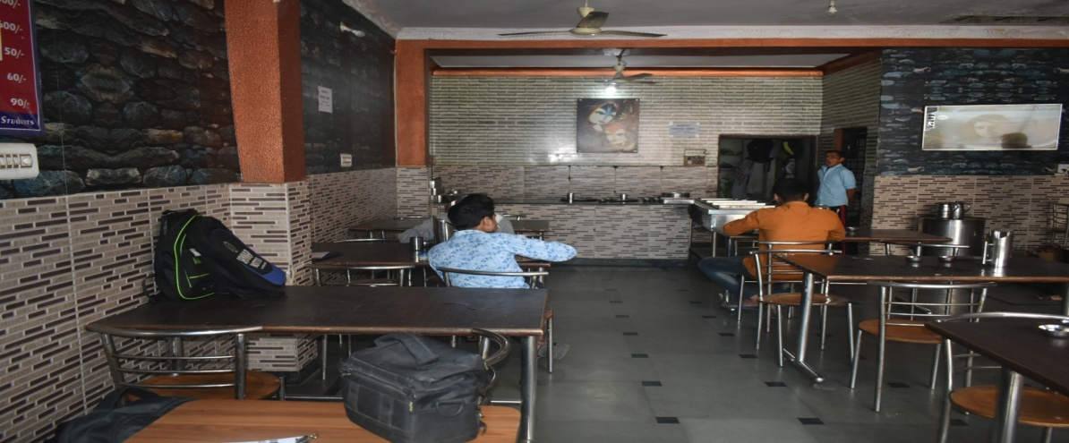


2. Company Overview
HIGHLIGHTSS
is

Slide 3
HIGHLIGHTS
04
02
03
01
Target size of the food service Mess sector is estimated to be worth around $48 billion in 2022
12-15% sector is expected to grow annually
The ask is
1 Cr. For the 10 % Equity
$ 8,00 is LTV for single customer
Pre-Revenue $ 5,000
Notes:
Let us look at some of the highlights of Bluwages journey so far

Slide 4

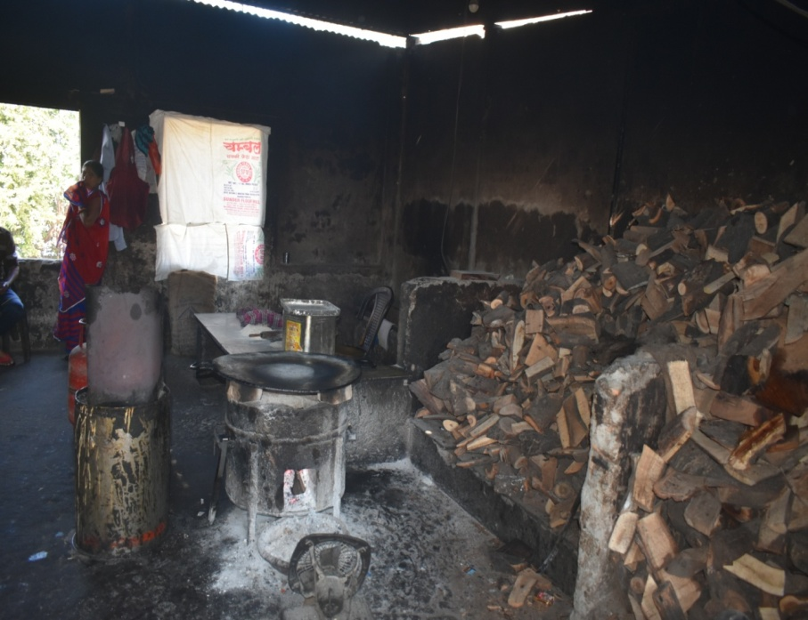
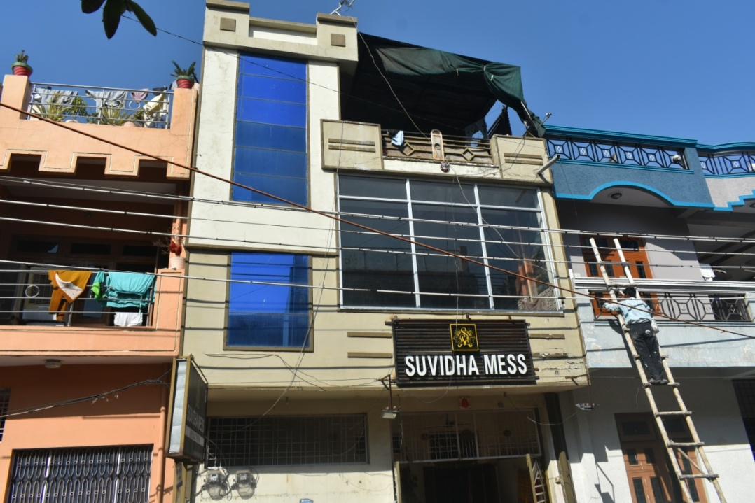
1. Problem
Students, professionals, travelling & urban peoples are using unbranded mess for their daily meal. Unbranded mess are providing low hygiene food and no ease of experience in Mess. Each types of consumers either take daily unhygienic food or he order very expensive food from online. On other hand consumers have daily only one choice of mess with fixed one menu.
VEGANISM TREND
HEALTH CONSIOUSNESS
CLEAN LEBEL
DIET FRIENDLY
Challenges
vs
Quality
Staff Training
Price
Standardization

Slide 5
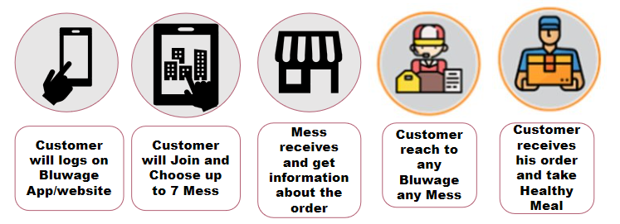



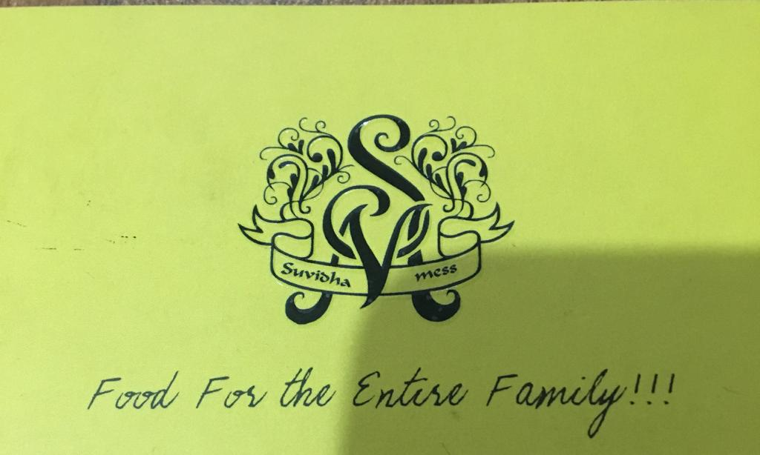

2. SOLUTION
Bluwage trying to solve the problem of the three mentioned segments in above to last slide buy providing “Low Cost high hygienic meal” We are also able 2 solve the ease of experience in Mess with different daily menu meal in different different branded Bluwage Mess. We are making a chain of branded mess all over India by converting all unbranded Mess
PROCESS
PARTNER

Slide 6

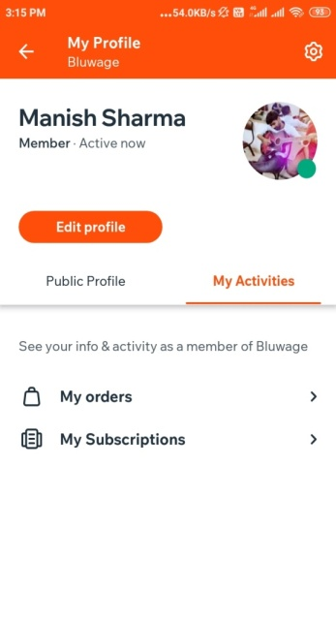
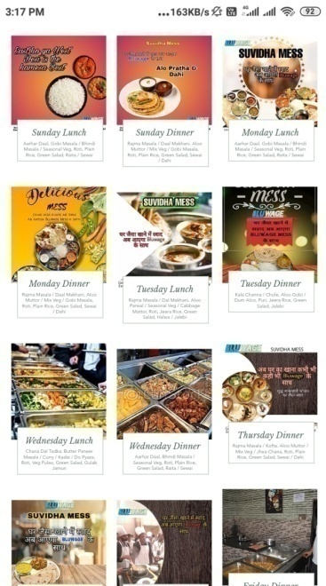
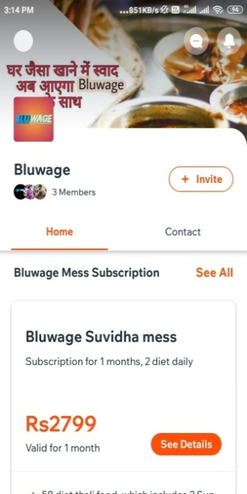
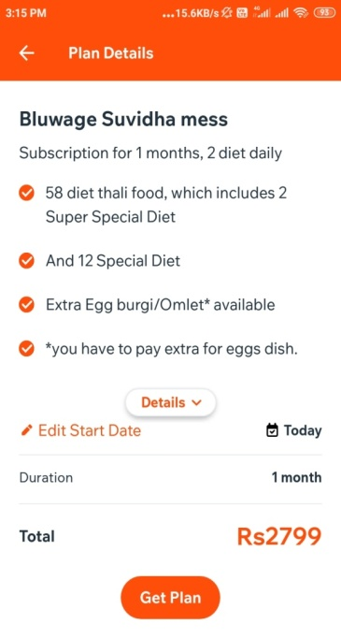
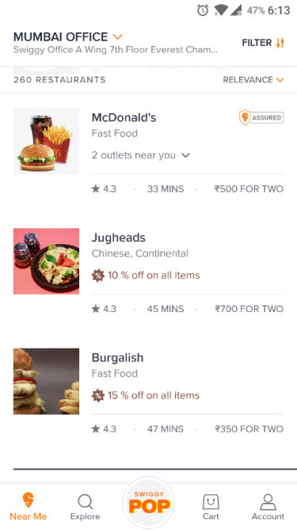
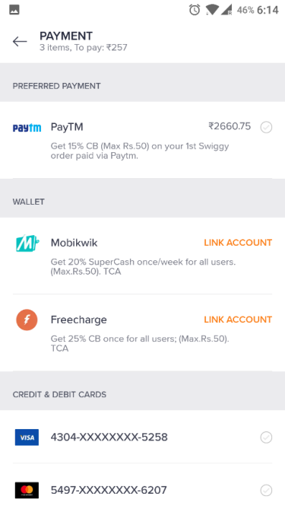
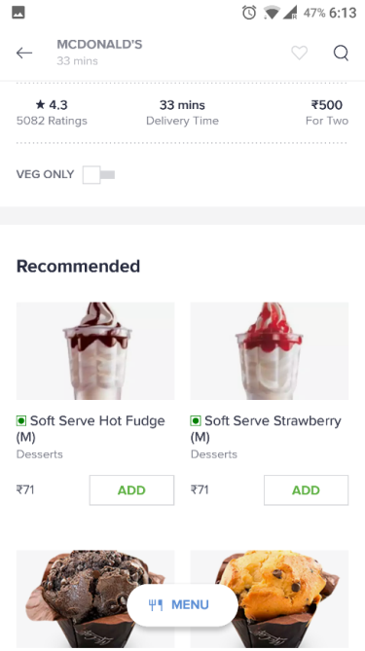
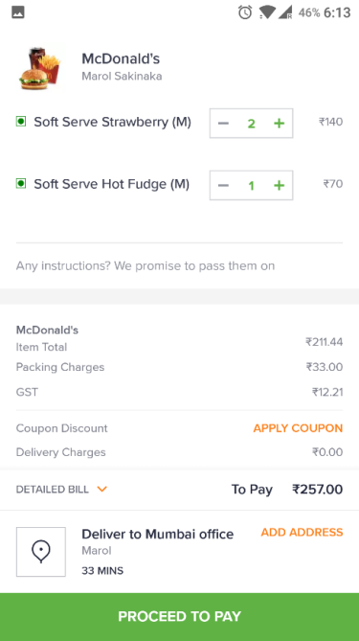
3. CONSUMER APP
How customers place an order on Bluwage App.
Profile Listing
Menu
Cart
Payment
Notes:
How many of you have seen the Bluwage app ?Have you used it ??.
Participants who do not have the app to download the app and register. Lets download it right away …

Slide 7


4. VALUE PROPOSITION
Ease of Mess Search
Easy Check-IN/OUT
World class service
Ease of Food Quality
End to End Responsibility
DE and Mess Partner
Pay Digital
Up to 7 Mess service

Slide 8
Customer Places the order on the App/Web
5. ORDER PROCESS FOR MESS
The order is relayed to the respective mess by the partner app
Accepts the order
Call Back
(mess can’t cancel)
No Response
Customer can choose upto 7 mess and enjoy food according to his choice
An IVRS call goes to the partner at the 2nd,4th and 6th min.(Reminder call)
If there is no acceptance till the 7th minute then a placer will be assigned and the order will be placed manually to the Mess
the same will be visible in the Mess owners’s app.
Acceptance will be counted within 3 mins

Slide 9




6. Business Model
For each order that is placed, there is a commission of 12-18% that Bluwage charges as service and platform fees which are defined in the service agreement between the mess and Bluwage.
Strategy
1. On Net Bill and Mess doesn’t charge Taxes
A Mess does 10000 RS (doesn't charges taxes) worth of business from Monday to Sunday. He is signed on 15% Net Bill.
Particulars | In Rs
Mess Weekly GMV ( Monday to Sunday Orders) | 10000
Service fees (15%) | (-)1500
GST charged by Bluwage (15% of 1500) | (-) 225
Payment made to his account | 8275
ASSET LIGHT STRATEGY
END TO END RESPONSIBILITY FOR CUSTOMERS EXPERIENCE
PREDICTABILITY WILL BRING REPEATABILITY
TECHNOLOGY FOR SPEED & SCALE
FOCUSED TEAM FOR ACQUISITIONS & EXPANSION
FEEDBACK TO FEEDFORWORD
LOWEST ATTRITION WITH CONTINUOUS TRAINING

Slide 10

7. Market Size
"Bluwage's vision is to elevate the quality of life of students and urban consumers by offering unparallel convenience in mess"
TAM
48B+
SAM
SOM-25B
34B

Slide 11
8. Financial Projection
We are currently pre-funded from Friend & Family
burn cash of up to 2L. Our business
model is expected to yield
substantial revenue growth, with a growth multiple of:
'3x' Year-on-Year

Slide 12




9. Fund Requirement and Utilization
Sales & Marketing 20%
Technology 35%
Operational cost 35%
Scaleup other 10%
Raising INR. 1 Cr.
Committed
SFO New York
Angel Investor: $10000
Conversation
Nidhi Grant

Slide 13
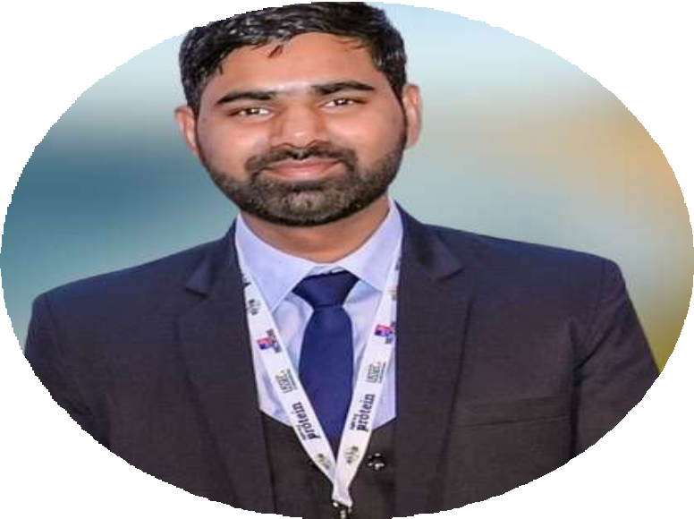
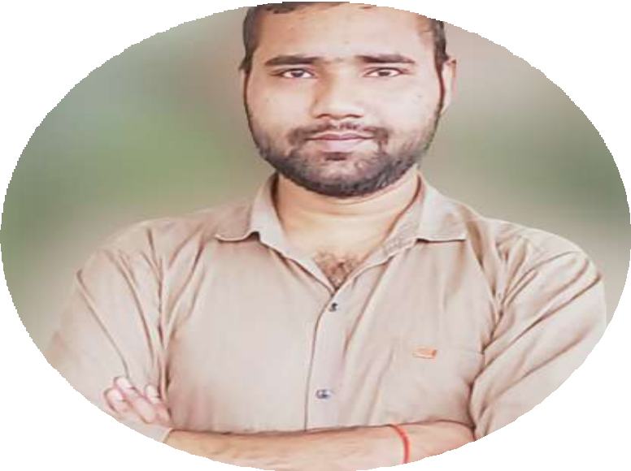
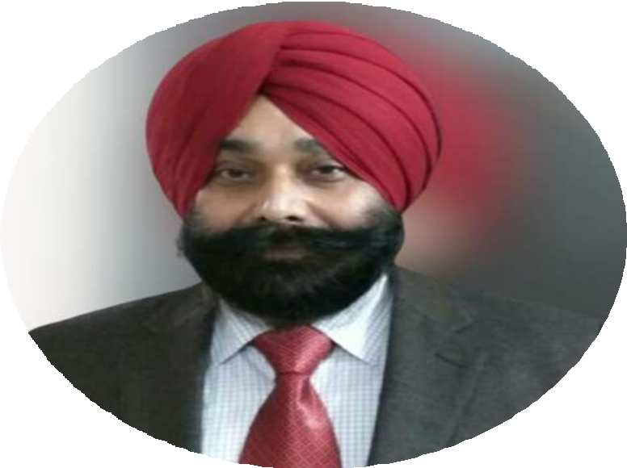
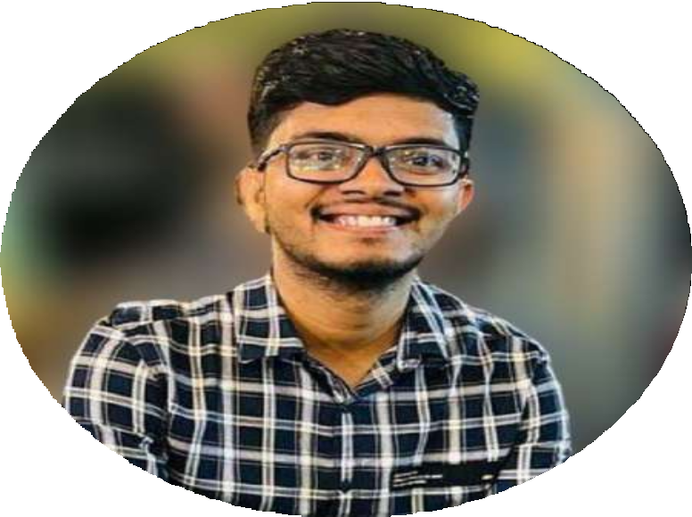





Manish Sharma
Mangesh Sharma
Dr. PS Bilga
Suraj Kumar
10. Team
The Rising Innovators by Insights Success
Founder & CEO
Crisis Management- Babson College USA, B.tech- GNDEC Ldh, IIM Udaipur
Director
M.tech- SVNIT Surat, B.tech- NIT M
Advisor
Advisor Ph.D. IIT, Delhi M.Tech.- IIT Delhi
Head of Department- GNDEC
Director
IIT K, GNDEC Ldh
Volvo Eicher Commercial Vehicles Indore

Slide 14
11. Thank You!
We are providing proper hygiene food with world class experience for the foodie of our country and other geographic like India with our branded mess.
CONTACT
+9180093-94035
ceo@bluwage.in , manishshrivas1999@gmail.com
https://www.bluwage.in/

Slide 15
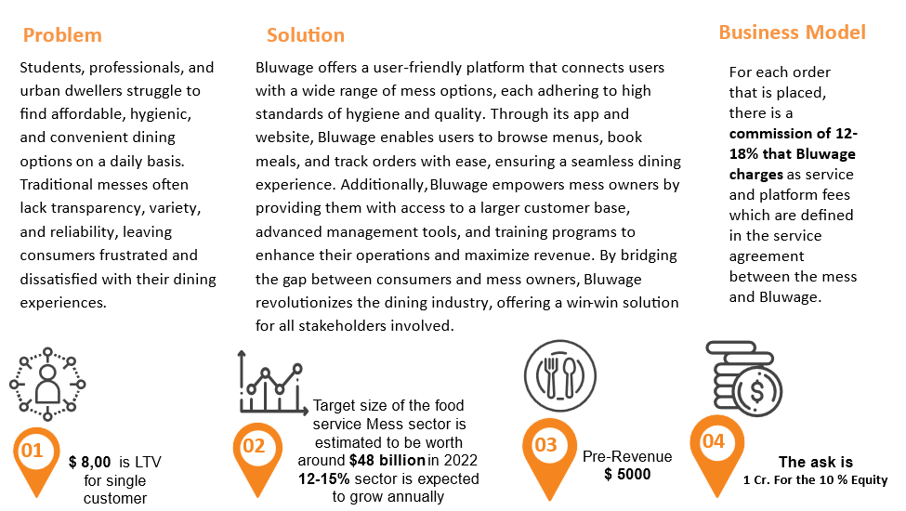

Slide 16
